Slide 1

Quantum Secure OTP Generator
(A Simulation of Quantum-Based Secure OTP Generation)
Presented By
Mutthuram S R
RA2411003010047
A1 SECTION
Faculty Incharge : Dr.M.Gayathri

Slide 2
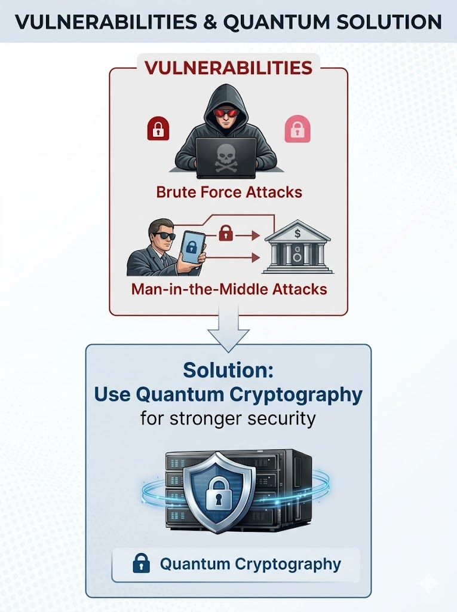
INTRODUCTION
OTP (One-Time Password) is used for authentication in banking, apps, etc.
It acts as a second layer of security (2FA) to protect user accounts.
Traditional OTP systems rely on classical algorithms.
These systems are vulnerable to:
Brute force attacks
Man-in-the-middle attacks
Solution : Use Quantum Cryptography to generate highly secure and unpredictable OTPs.
Quantum-based systems provide:
True randomness
Enhanced data security
Resistance to advanced cyber attacks

Slide 3
ABSTRACT
This project presents a Quantum Secure OTP Generator for advanced authentication.
It leverages key concepts of:
Quantum randomness
Quantum Key Distribution (QKD)
The system generates highly secure and unpredictable OTPs using quantum-inspired techniques.
Unlike traditional methods, it ensures:
True randomness in OTP generation
Enhanced protection against cyber threats
The proposed model improves:
Data confidentiality
Authentication reliability
It provides strong resistance against:
Brute force attacks
Man-in-the-middle attacks

Slide 4
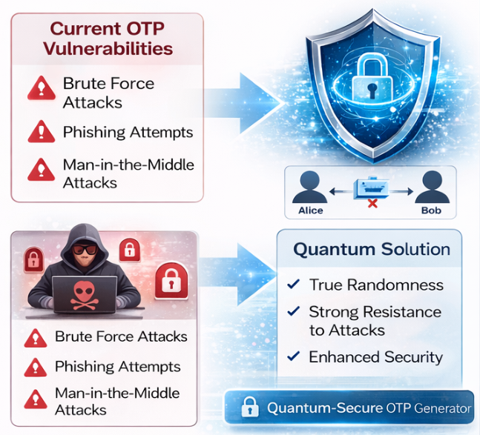
Problem Statement & Challenge
Current OTP systems are :
not fully secure against advanced attacks.
OTPs can be intercepted during transmission
Vulnerable to phishing and social engineering attacks
Dependence on network security and device safety
Need a system that:
Generates truly random OTPs
Cannot be predicted or duplicated
Ensures end-to-end secure OTP generation
Provides real-time secure authentication
Challenges:
Achieving true randomness using classical systems is difficult
High complexity in integrating quantum techniques with existing systems
Limited availability of real quantum hardware for implementation

Slide 5
Literature Survey
implementation of quantum-based OTP systems
Security of Quantum Key Distribution with One-Time-Pad-Protected Data (2023) → Combines OTP with QKD to achieve highly secure communication.
Enhanced Approach to Generate OTP using Quantum True Random Number Generator (2024) → Uses quantum randomness to generate unpredictable OTPs.
Quantum Randomness for Secure Authentication Systems (2024) → Applies QRNG in OTP and authentication to improve security.
Quantum True Random Number Generator using IBM Quantum Devices (2022) → Demonstrates real quantum randomness using Qiskit.
Fast and Simple Quantum Cryptography for One-Time Pad (2017) → Solves key distribution issues in OTP using quantum methods.
Quantum-Resilient OTP-based Multi-Factor Authentication (2024) → Proposes OTP systems secure against future quantum attacks.
A Review of Quantum Random Number Generators (2022) → Explains types and importance of QRNG in cryptography.
Quantum Random Number Generation in Encryption Security (2023) → Shows how QRNG strengthens encryption and security systems

Slide 6
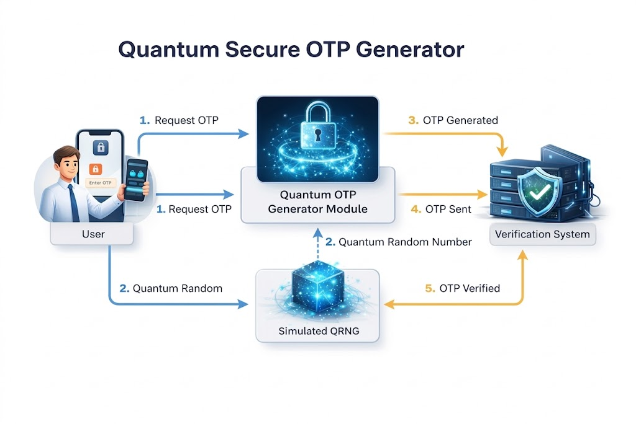
Design of Architecture
Components:
User Interface
OTP Generator Module
Quantum Random Number Generator (QRNG) (simulated)
Verification System
Flow:
User requests OTP
Quantum random number generated
OTP created
Sent to user
Verified at server

Slide 7
Modules
User Module
Request OTP
Enter OTP for verification
Quantum OTP Generator
Generates random numbers using quantum principles (simulated)
Authentication Module
Validates OTP
Security Module
Prevents reuse
Time-based expiry

Slide 8
Conclusion
Quantum Secure OTP provides:
Higher security than traditional OTP
True randomness
Reduces risk of cyber attacks
Future scope:
Real quantum hardware integration
Use in banking & defense systems

